Slide 1
Single-Cell Cancer Biopsy Prediction with Transfer Learning
Group A:
Mica Haney
Mani Dhakal
Danyang Shao

Slide 2
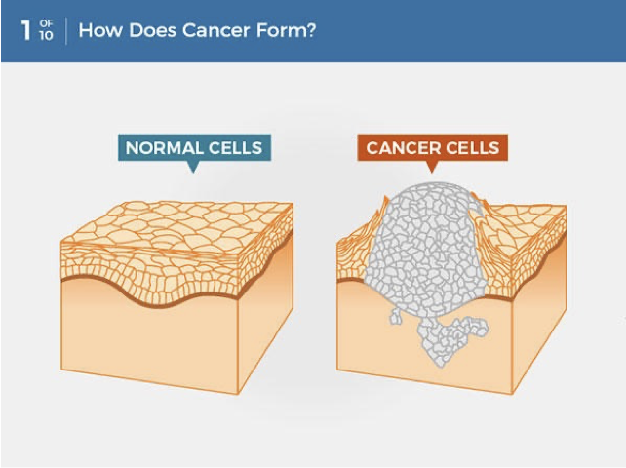
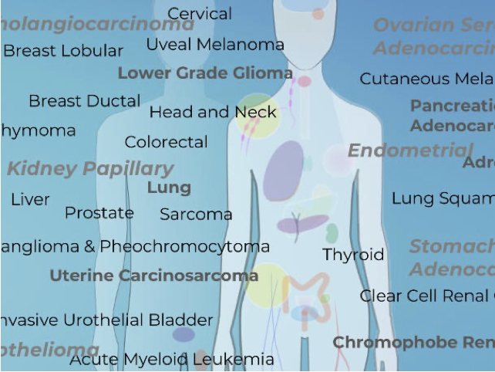
Introduction
Cancer is a disease in which some of the body’s cells grow uncontrollably and spread to other parts of the body.
A total of 1.9 million new cancer cases and 609,360 deaths from cancer are expected to occur in the US in 2022, which is about 1,670 deaths a day.
Cancer mortality is reduced when cases are detected and treated early.
A national priority to improve early diagnosis rates to 75% by 2028 was outlined in the National Health Service (NHS) long-term plan.

Slide 3
Introduction
Deep learning algorithms have the potential to directly contribute to cancer diagnosis by processing large amounts of high-dimensional data to identify hard-to-detect signals.
Currently there is not a lot of data available to train, so models trained with a end to end approach will not be robust, particularly rare ones.
The problem will be tackled with transfer learning, a method of fine-tuning that allows for the use of large source dataset to built the initial representations of the domain data while a small target datasets tunes the model to the specific data for the task at hand.

Slide 4
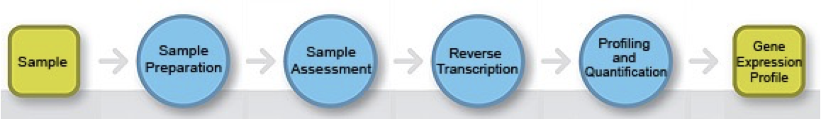
Introduction
Gene Expression Analysis
Gene expression analysis is most simply described as the study of the way genes are transcribed to synthesize functional gene products — functional RNA species or protein products. The study of gene regulation provides insights into normal cellular processes, such as differentiation, and abnormal or pathological processes

Slide 5
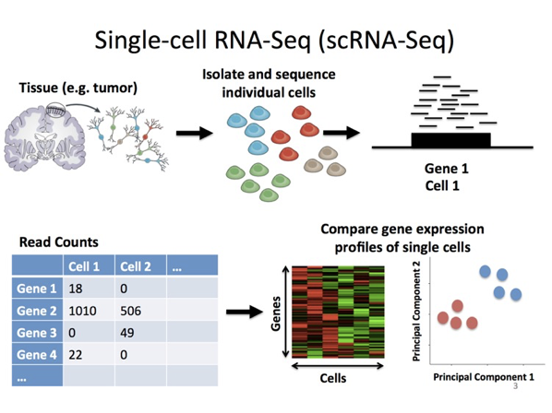
Introduction
Bulk-RNA-seq averages gene expression across all cells in a sample, scRNA-seq profiles the transcriptome of each individual cell in the tissue sample.
Single cell RNA sequencing allows us to classify, characterize and distinguish each cell at the transcriptome level, which leads to identify rare cell population but functionally important.

Slide 6
Introduction
Database
The Cancer Genome Atlas (TCGA), a landmark cancer genomics program, molecularly characterized over 20,000 primary cancer and matched normal samples spanning 33 cancer types.
Gene Expression Omnibus (GEO) is a database repository of high throughput gene expression data and hybridization arrays, chips, microarrays.

Slide 7
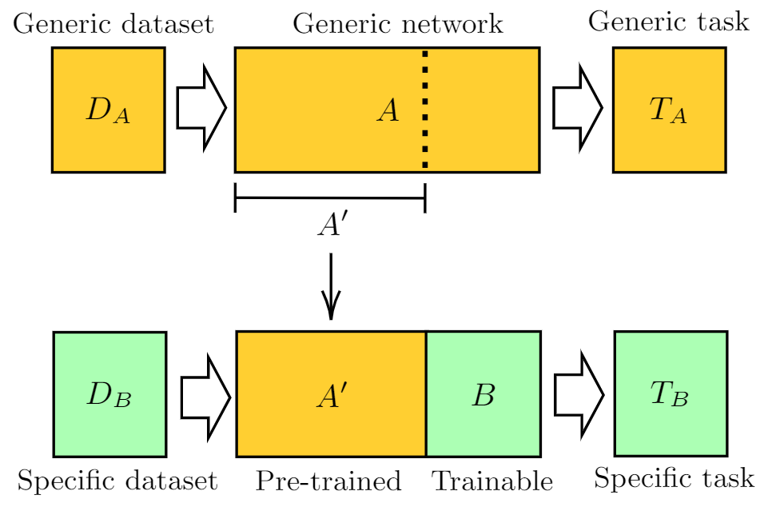
Data
Transfer learning requires two datasets: source and target.
Our source dataset is multi-cell biopsy data.
Our target dataset is single-cell biopsy data.

Slide 8
Multi-Cell Biopsy Data
Bulk RNA data of 32 cancers and control are downloaded from TCGA.
gdc-client is used for downloading.
XML generates a single patient information data frame with only one row.
Check if the order of gene id is consistent and merge by column to get the count matrix.
cart-json is used to convert to sample id.
Removal of duplicate genes.
After preprocessing, there were 124,000 sequences from 31 classes. Samples from healthy cells were removed.
LAML151，ACC79, CHOL45, BLCA430, BRCA1217, CESC309, COAD512, UCEC583, ESCA173, GBM173, GHSC546, KICH89, KIRC607, KIRP321, DLBC48, LIHC424, LGG529, LUAD585, LUSC550, SKCM472, MESO86, UVM80, OV379, PAAD182, PCPG186, PRAD551, PCPG186, PRAD551, READ177, SARC265, STAD407, TGCT165, THYM121, THCA568, UCS56.

Slide 9
Single-Cell Biopsy Data
Single-Cell RNA of 2 cancers are download from GEO using GEOquery.
Ovarian cancer GSE146026, and Colorectal cancer GSE132465.
Seurat is an r package designed for cellular quality control and analysis of single cell rna-seq data
Data normalization is performed with Seurat.
FindVariableFeatures was used for selecting highly variable genes.
After preprocessing, there were 64000 sequences from 2 classes.

Slide 10
Data: Preprocessing
All data was converted to sequence lengths of 200.
Missing values were first dropped.
Then sequences under the minimum length (8000), were repeatedly concatenated with themselves with a spacer value (0) in between repetitions.
Each sequence was then divided into 200-value lengths. Any subsequences with less than 200 values were discarded.
Labels were numeric encoded.
Class balancing was done. All classes have equal representation in their respective datasets.

Slide 11
Data: Issues
There was far more data collected than was trained over. However, it was prohibitively difficult and time-consuming to work with so much data.
Data is taken from multiple sources with varying formats for the single-cell biopsy data. There is concern about the quality of the combined single-cell dataset.

Slide 12
Model Architecture
Two model architectures were trained, a dense and a LSTM.
Both architectures have 3 hidden layers with unit sizes of 200, 100, and 50.
ReLU activations were used for the hidden layers, and softmax for the output layer.

Slide 13
Experiments
For each architecture, 3 training sessions were done.
A baseline was run where the target data was trained on as the only dataset.
A source model was trained on the multi-cell biopsy dataset.
The source model was converted to a transfer model, and fine-tuned on the single-cell biopsy dataset. 2 layers were unfrozen.
The first experiment was run at 20 epochs, the last two at 10 for a combined total of 20 epochs.

Slide 14
Experiments: Issues
Originally far more experiments were planned.
More architectures were intended to be attempted (transformers, CNN).
Different segmentation styles were intended to be attempted (varying spacer sizes, padding, different sequence lengths).
Time constraints occurred due to how long it took to process the data, and notable issues with getting the model to accept the data.

Slide 15
Results
Architecture | Model | Precision | Recall | F1 | Accuracy
Dense | Source | 0.000991 | 0.032258 | 0.001923 | 0.030726
Dense | Target | 0.979746 | 0.978288 | 0.978567 | 0.471563
Dense | Baseline | 0.999846 | 0.999842 | 0.999844 | 0.999844
LSTM | Source | 0.020670 | 0.037464 | 0.010124 | 0.038629
LSTM | Target | 0.000000 | 0.246953 | 0.500000 | 0.330614
LSTM | Baseline | 0.787013 | 0.786902 | 0.786712 | 0.786719

Slide 16
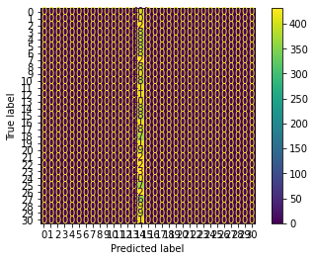
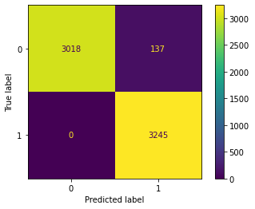
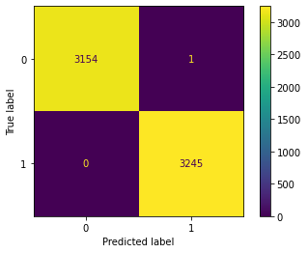
Dense Confusion Matrices

Slide 17
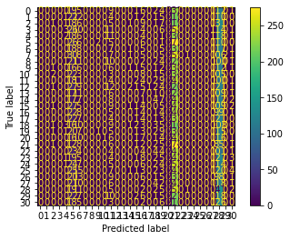
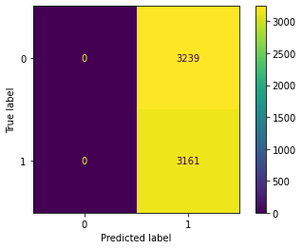
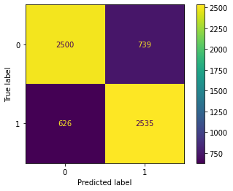
LSTM Confusion Matrices

Slide 18
Discussion
The data problem was unexpected.
The baseline results are better than the transfer learning results. However, for the Dense model the transfer learning is close.
Scores indicate that a LSTM architecture is either not appropriate, or needs significantly more training.
Training with more data should be done.

